Slide 1
Neutron stars
Source:Kurzgesagt – In a Nutshell

Slide 2
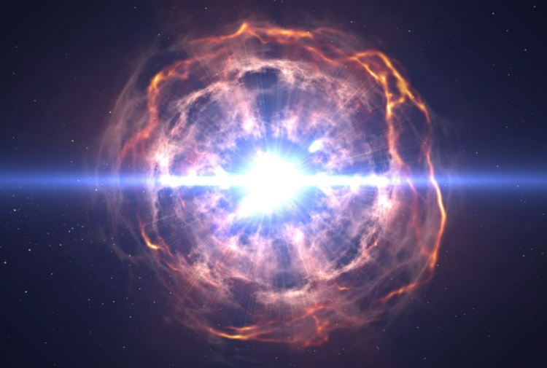
Introduction
The neutrons stars born from the explosion of the stars with a big mass, who collapse and then explode.

Slide 3
What happen when a star die
What appen inside the star?
This is a natural balance and when it collapse:
The stars who have a medium mass
The stars who have a big mass

Slide 4
The star with a mass bigger than the Sun
Inside the core:
1)Carbon->Neon
2)Neon->Oxygen
3)Oxygen->Silicon
4)Silicon->Iron

Slide 5
How neutron star born
Iron doesn’t have energy to relase
What happen inside the iron atoms
Characteristics of neutron stars

Slide 6
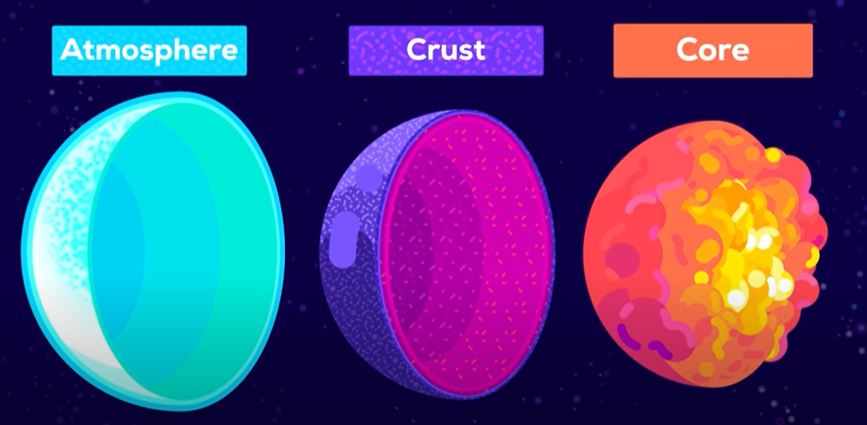
Inside the Neutron star

Slide 7
death of a neutron star
In single
with a partner

